Slide 1
ELEMENTS OF ENGINEERING ME144
Prof. Bhargav Shobhana
Department of Civil Engineering
bhargavshobhana.cv@charusat.ac.in

Slide 2
Syllabus
11. | Introduction to Surveying
11.1 | Definition of surveying
11.2 | Objects of surveying, Uses of surveying
11.3 | Primary divisions of surveying, Principles of surveying
11.4 | List of classification of surveying, Definition: Plan and Map, Scales : Plain scale and Diagonal scale, Conventional Symbols
11.5 | Introduction to linear and angular measurements, Concepts of land profiling

Slide 3
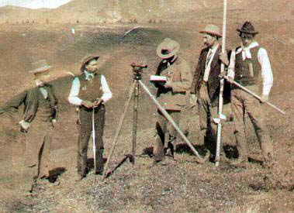
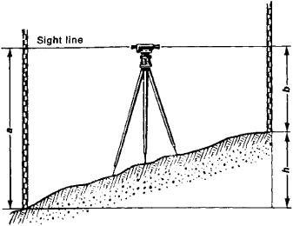
Surveying and levelling
Surveying: Is the art of determining the relative position of various points above, on or below the surface of the earth.
Levelling: Is the art of determining the relative vertical distance of different points
Measurement Taken
Vertical distance
Horizontal Distance
Angle
Horizontal
Vertical
Computation
Preparation of maps and plans
Used for
Calculation of length
Area
Volume
Art of tracing the points on a map to the ground
Purpose of the surveying:
Take measurements to determine the relative position of the point
Make layouts , maps or plans to mark the proposed position of structure on the surface
Determine the area, volume and other relative quantity.

Slide 4
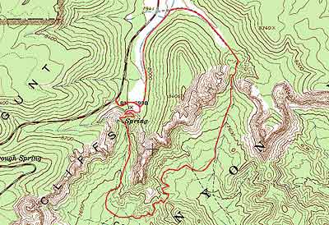
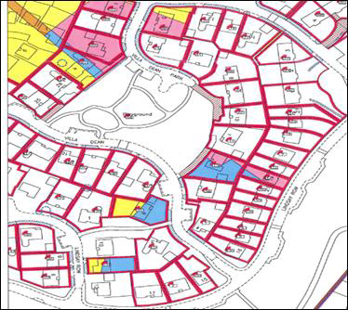
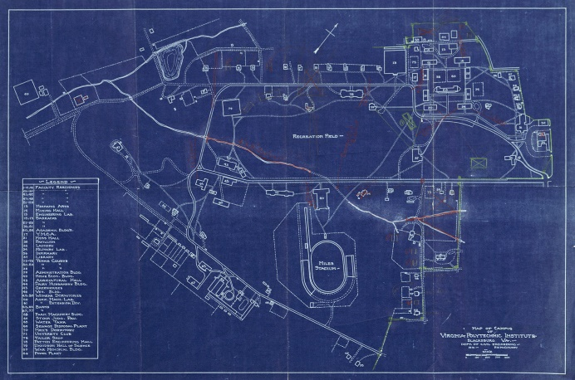
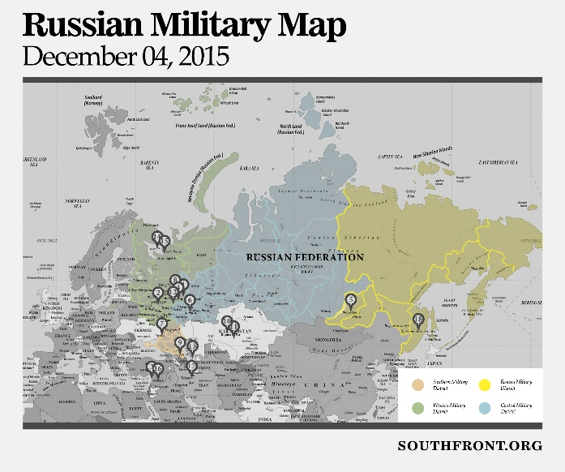
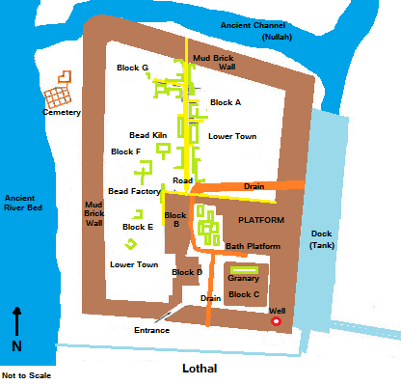
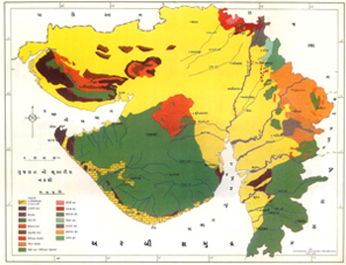
Use of Surveying
Preparation of Map
To prepare the topographical maps
Prepare cadastral maps showing boundaries, houses and properties
Engineering map
Military map
Geological map
Archaeological map

Slide 5
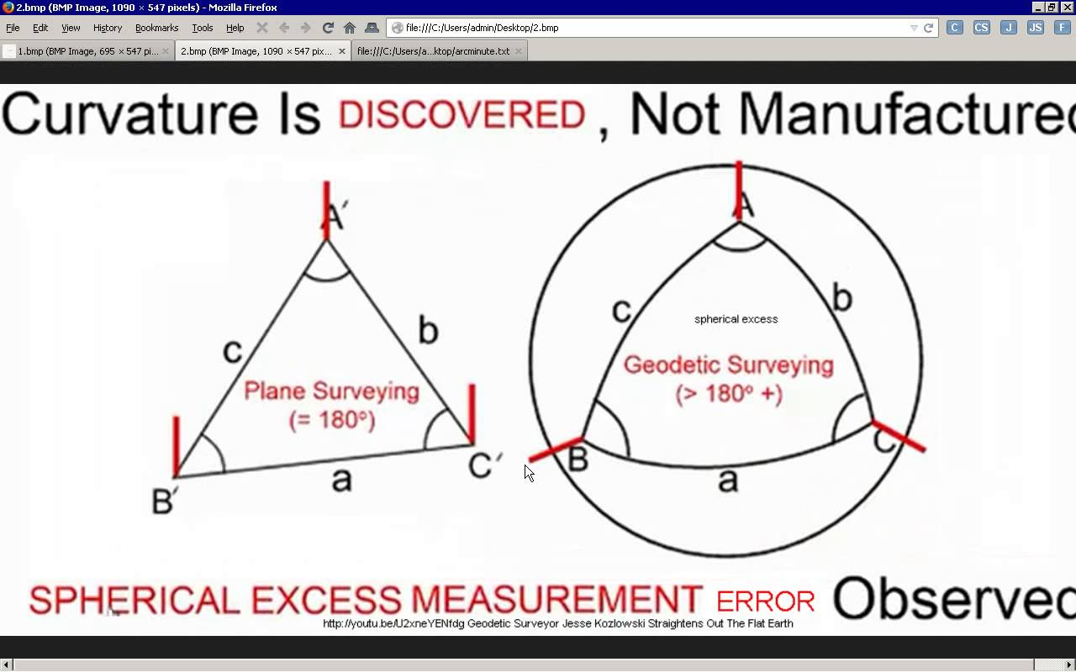
Primary Divisions of Surveying
Primary Classification:
Division is based on the basis weather the curvature of the earth is taken in to consideration or not
Plane Surveying :
Curvature of earth is neglected and assumed as plane surface
Horizontal surface:
Vertical line:
Plane survey can be used when considered for a small area (Less than 250 Km²)
Degree of accuracy is comparatively low
Geodetic surveying
Curvature of earth is taken in to consideration
Large distance and large area
Refined methods of observation and adjustment

Slide 6
Difference between plane survey and geodetic survey
Plane Survey
Curve of the earth is ignored
Used for relatively small area (<250 SqKm)
Used for establishing relatively less important area
Direction of plumb lines are assumed to be parallel to one another
Lower accuracy
Angle of triangle formed by any three line considered to be plane
Geodetic Survey
Curvature of earth is taken it to consideration
Used for larger area (>250SqKm)
Used for establishing precise points
Direction of plumb lines are different at various points
High accuracy and high precise instruments are used
Angle of triangle formed by any three line considered to be plane

Slide 7
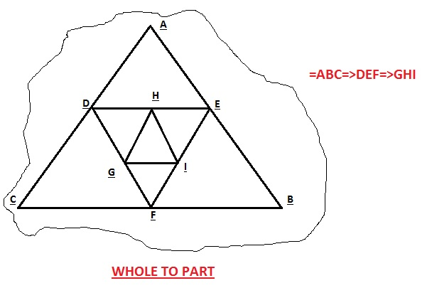



Principles of Surveying:
Work should be done from “whole to part” and not from “part to whole”
Position of new station should be fixed by at least two independent methods
R
R
R
$$√$$
$$√$$
$$√$$
R
$$√$$
$$√$$
$$√$$
P
Q
P
Q
P
Q
R
R
P
Q
$$√$$
$$√$$
$$√$$
$$√$$
P
Q
P
Q

Slide 8
Classification of Survey
A
Surveying
Nature of the field
Instrument used
Object of Survey
Method Used
8

Slide 9
Hydrographic Survey:
On or near the body of water.
Locating shore line
Estimation of water flow
Profiling of area beneath the water
Land Survey
Determining boundaries and area of land
Topographic survey:
City survey:
Engineering survey: design and planning of engineering work
Reconnaissance survey
Preliminary survey
Location Survey
Cadastral Survey: Boundaries of private bodies
Astronomical survey:
Determination of earth location (lat, long, time by observing astronomic bodies
Aerial Survey
Conducted from aircraft
Photographs were taken and study
Classification Nature of the field
B
Nature of the field
Hydrographic
Astronomical
Land
Aerial Survey
Cadastral
City
Topographic
Engineering

Slide 10
Classification based on objective of survey
Classification based on Method used
D
Method
C
Objective
Triangular Survey
Travers survey
Control Survey
Military survey
Archaeological survey
Mine survey
Geological Survey
Classification based on instrument used
E
Instrument
Chain
Theodolite
Compass
Tacheometric survey
Plane table Survey
Photometric Survey

Slide 11
Plans and Maps
Plan
Plans are a set of two-dimensional diagrams or drawings used to describe a place or object, or to communicate building or fabrication instructions
Plans are usually scale drawings, meaning that the plans are drawn at specific ratio relative to the actual size of the place or object.
Plans are large scale (1:10, 1: 20 etc)
Map
A map is a visual representation of an area—a symbolic depiction highlighting relationships between elements of that space such as objects, regions, and themes
Many but not all maps are drawn to a scale, allowing the reader to infer the actual sizes of, and distances between, depicted objects
Maps are small scale (1:1000, 1:5000 etc)

Slide 12
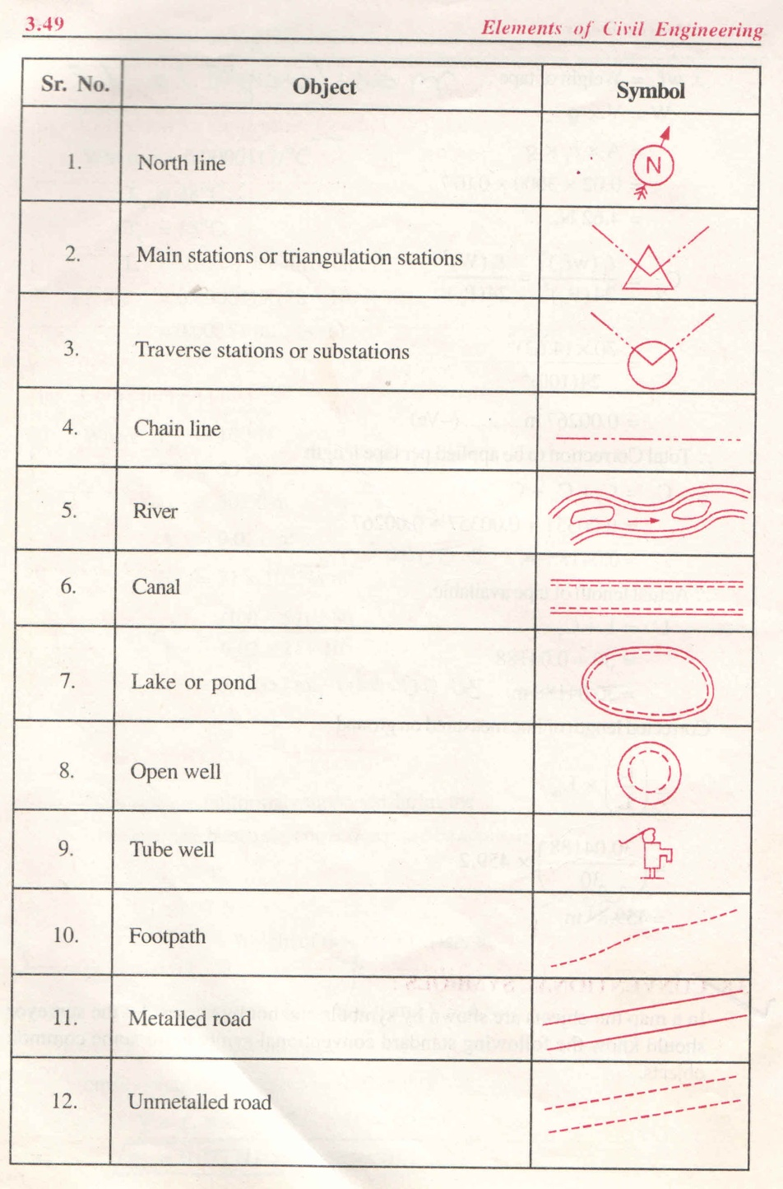
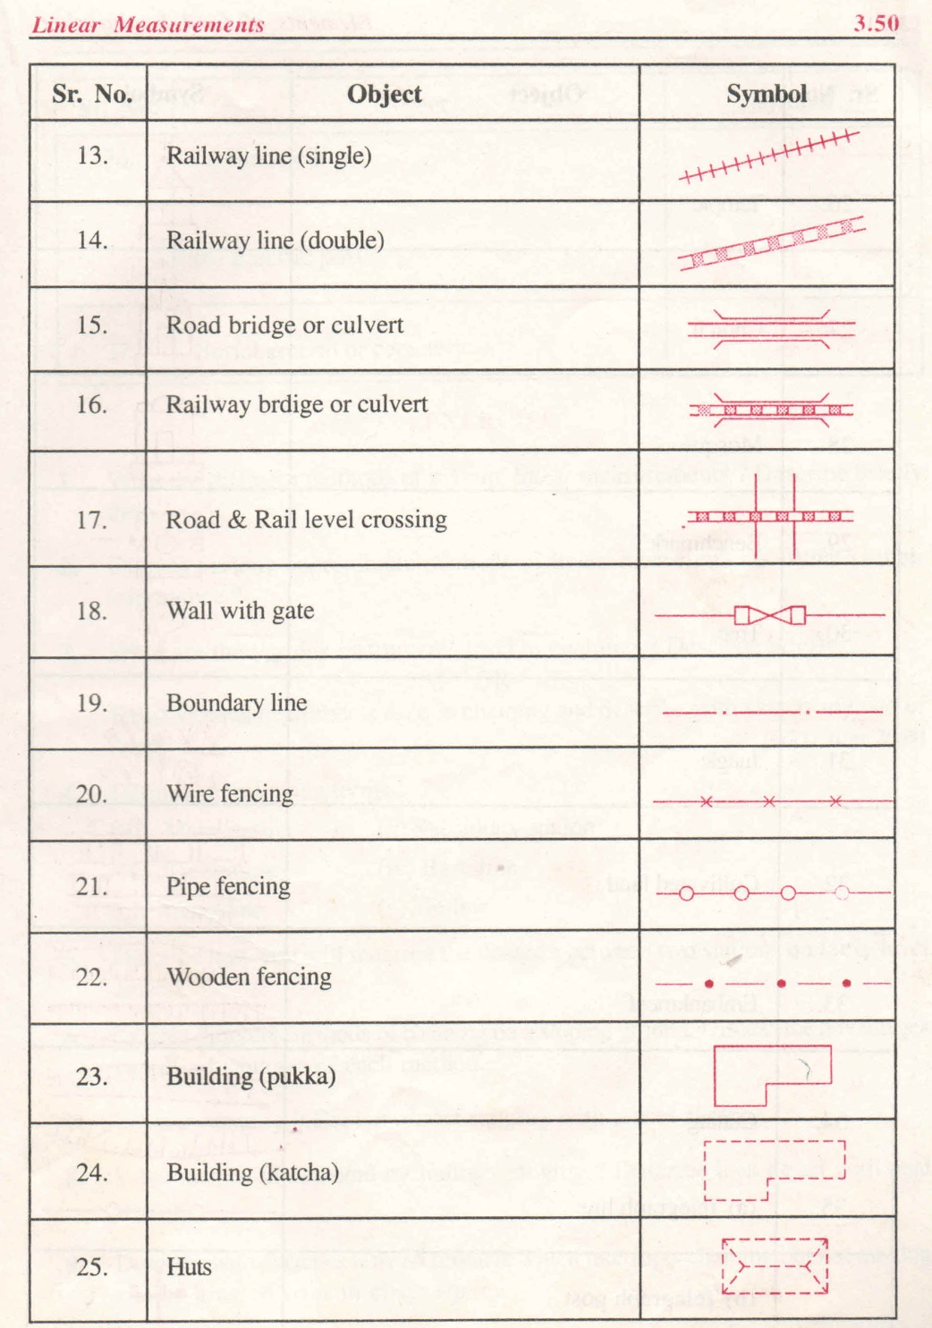
Conventional symbols

Slide 13
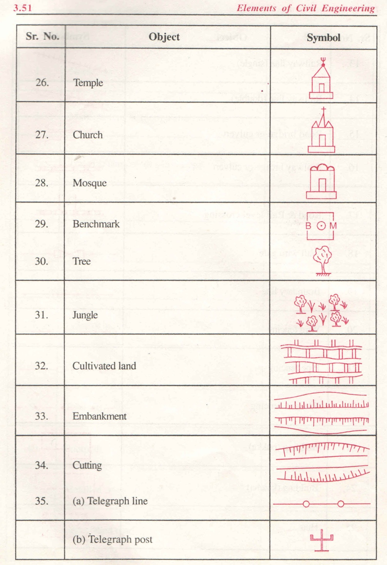
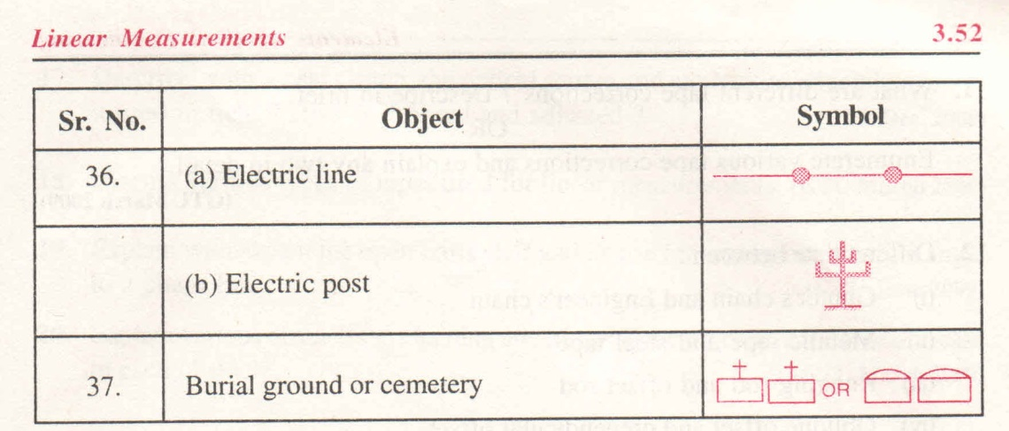
Conventional symbols

Slide 14
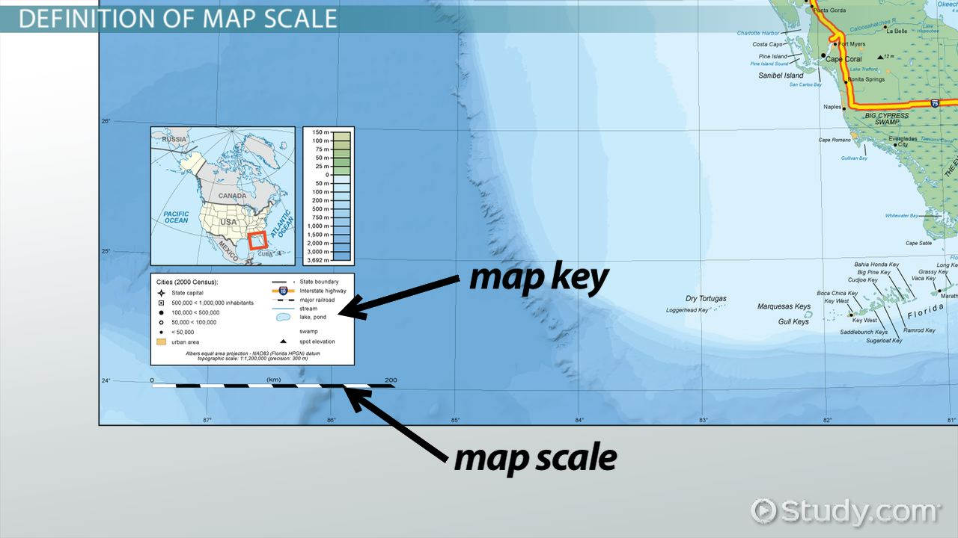
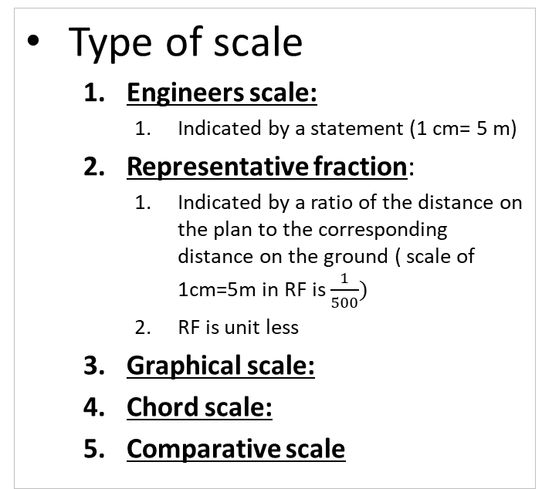
Scale
Scale: Is the ratio of distance on the paper (Plan or map) to the distance on the ground
Scale= $\frac{Plan distance}{Ground distance}$
Selection of scale depends on
Purpose
Size
Required precision
Classification
Large scale: 1cm =10 m or less than 10m
Medium scale: 1cm = 10 m to 100 m
Small : 1 cm = 100m or more than 100m
Type of scale
Engineers scale:
Indicated by a statement (1 cm= 5 m)
Representative fraction:
Indicated by a ratio of the distance on the plan to the corresponding distance on the ground ( scale of 1cm=5m in RF is $\frac{1}{500})$
RF is unit less
Graphical scale:
Chord scale:
Comparative scale

Slide 15
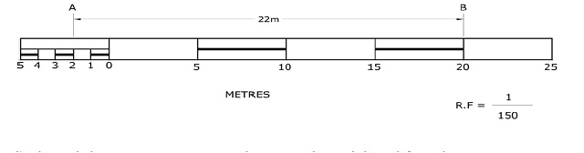
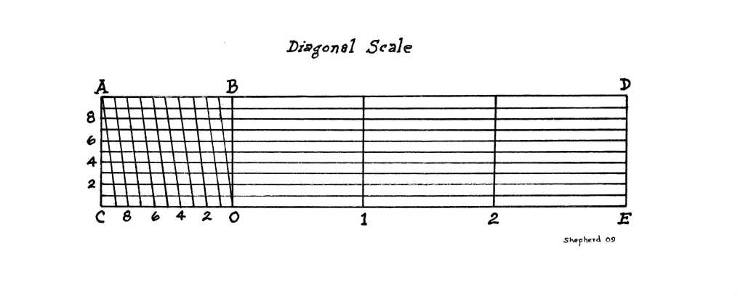
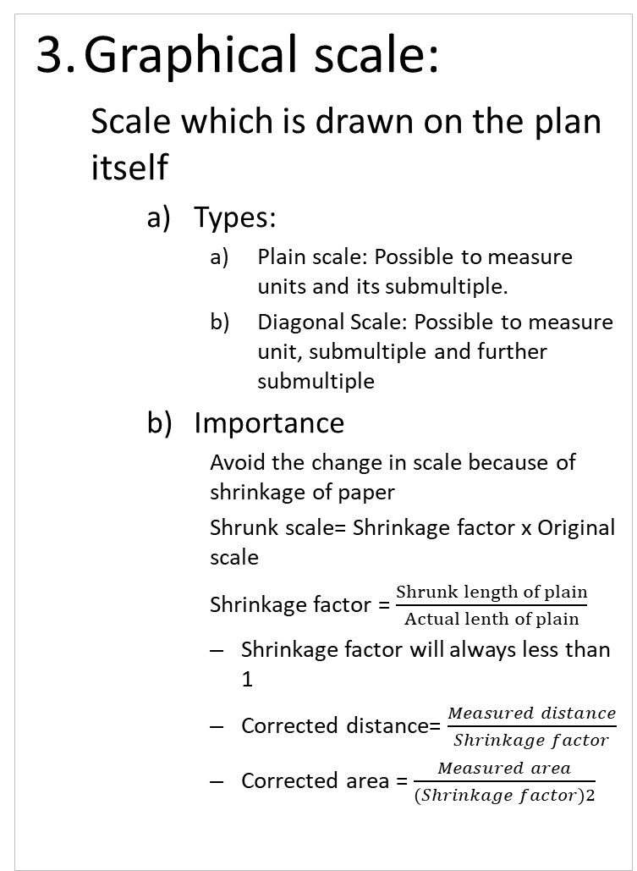
Scale
34
Graphical scale:
Scale which is drawn on the plan itself
Types:
Plain scale: Possible to measure units and its submultiple.
Diagonal Scale: Possible to measure unit, submultiple and further submultiple
Importance
Avoid the change in scale because of shrinkage of paper
Shrunk scale= Shrinkage factor x Original scale
Shrinkage factor = $\frac{Shrunk length of plain}{Actual lenth of plain}$
Shrinkage factor will always less than 1
Corrected distance= $\frac{Measured distance}{Shrinkage factor}$
Corrected area = $\frac{Measured area}{(Shrinkage factor)2}$
10 8 6 4 2 0
10
20
30
Plain scale
Diagonal scale
Comparative scale:
Designed to read two units of measures which are interconnected.
Representative fractions for both measures are same and can easily computed
Chord scale:
Is used to measure angles or set off angles with considerable accuracy

Slide 16
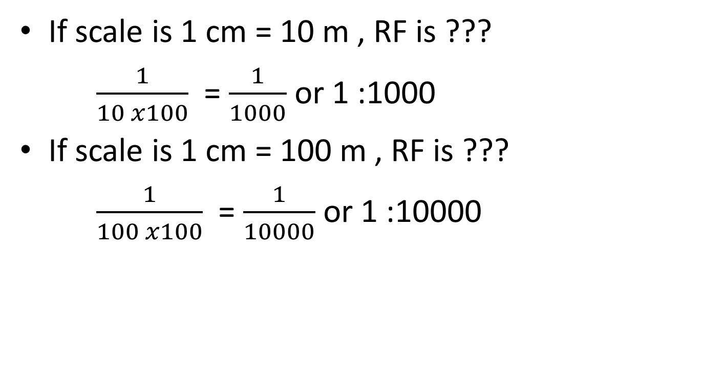
Examples
If scale is 1 cm = 10 m , RF is ???
$\frac{1}{10 x100}$ = $\frac{1}{1000}$ or 1 :1000
If scale is 1 cm = 100 m , RF is ???
$\frac{1}{100 x100}$ = $\frac{1}{10000}$ or 1 :10000

Slide 17
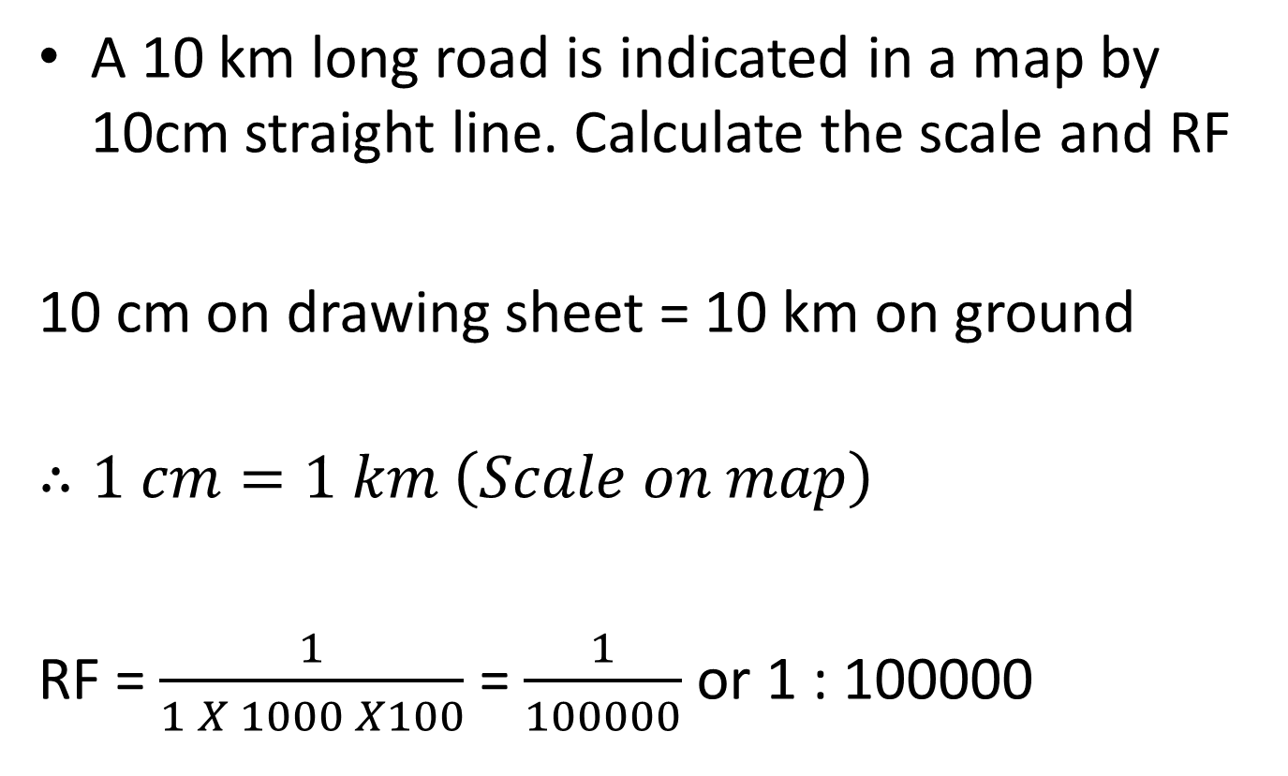
Example
A 10 km long road is indicated in a map by 10cm straight line. Calculate the scale and RF
10 cm on drawing sheet = 10 km on ground
$$∴1 cm=1 km \left(Scale on map\right)$$
RF = $\frac{1}{1 X 1000 X100}$ = $\frac{1}{100000}$ or 1 : 100000

Slide 18
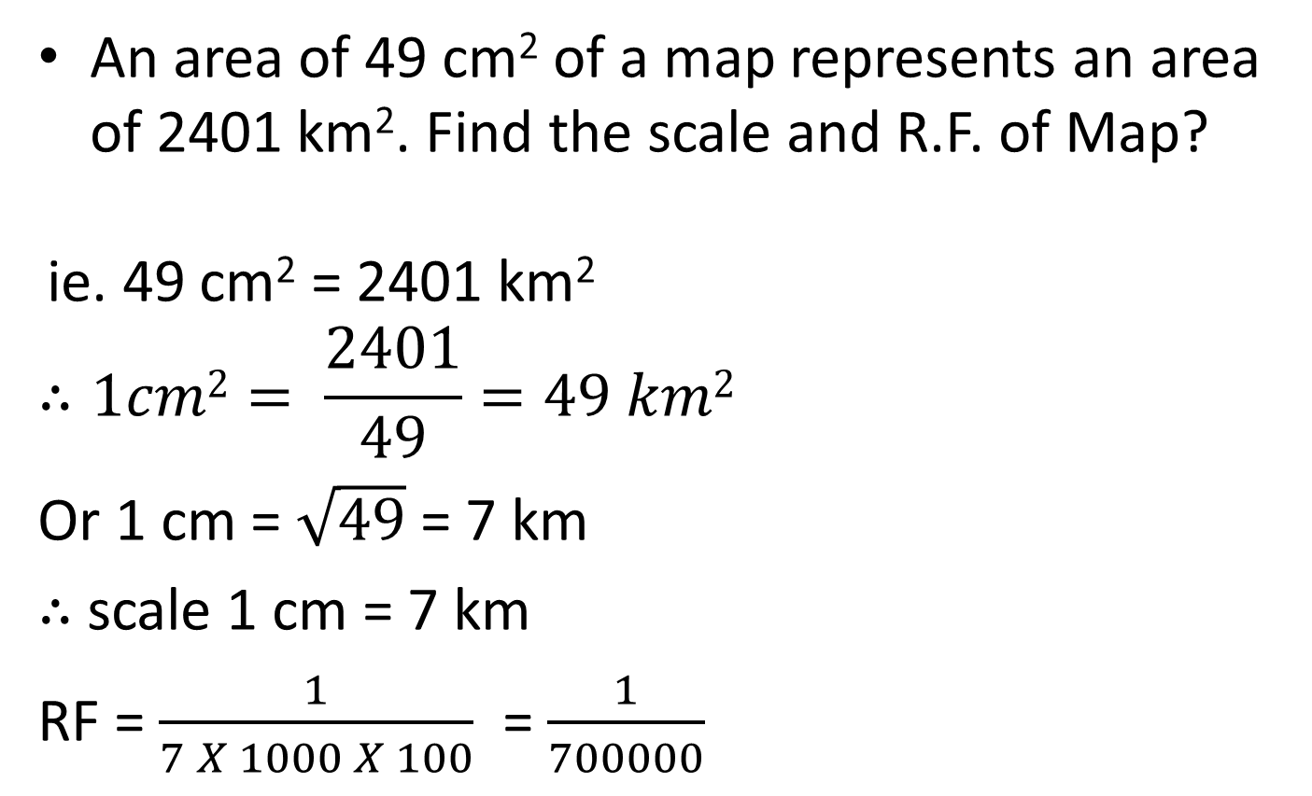
Example
An area of 49 cm² of a map represents an area of 2401 km². Find the scale and R.F. of Map?
ie. 49 cm² = 2401 km²
$$∴1cm2= \frac{2401}{49}=49 km2$$
Or 1 cm = $\sqrt{49}$ = 7 km
$∴$ scale 1 cm = 7 km
RF = $\frac{1}{7 X 1000 X 100}$ = $\frac{1}{700000}$

Slide 19
Example
Construct a plain scale of RF 1/500 to measure up to meters and represent 37 m on the scale.
Construct a diagonal scale of RF 1/500 to measure up to meters and represent 37.5 m on the scale.
37
10
0
10
20
30
38
37.5
10
37
0
10
20
30

